Slide 1


REACT JS

Slide 2
INTRODUCTION
React, sometimes referred to as a frontend JavaScript framework, is a JavaScript library created by Facebook.
React is a tool for building UI components.

Slide 3

HISTORY
Facebook Software Engineer, Jordan Walke, created it.
React.JS was first used in 2011 for Facebook's Newsfeed feature.
Initial Release to the Public (V0.3.0) was in July 2013.
Current version of React.JS is V18.0.0 (April 2022).

Slide 4

FEATURES
Fast-Virtual DOM.
Pure JS.
Component Based.
Used For Single/Multi Page App.

Slide 5
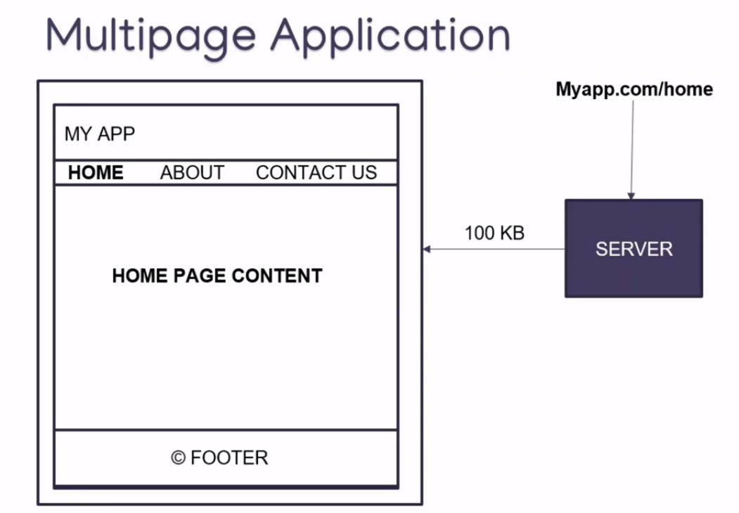

Slide 6
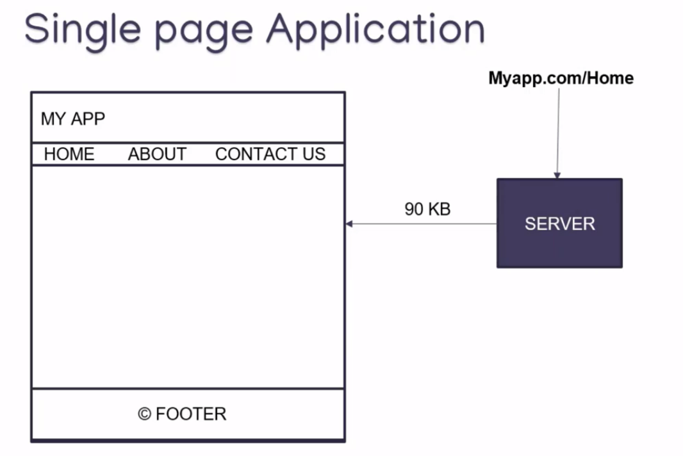

Slide 7
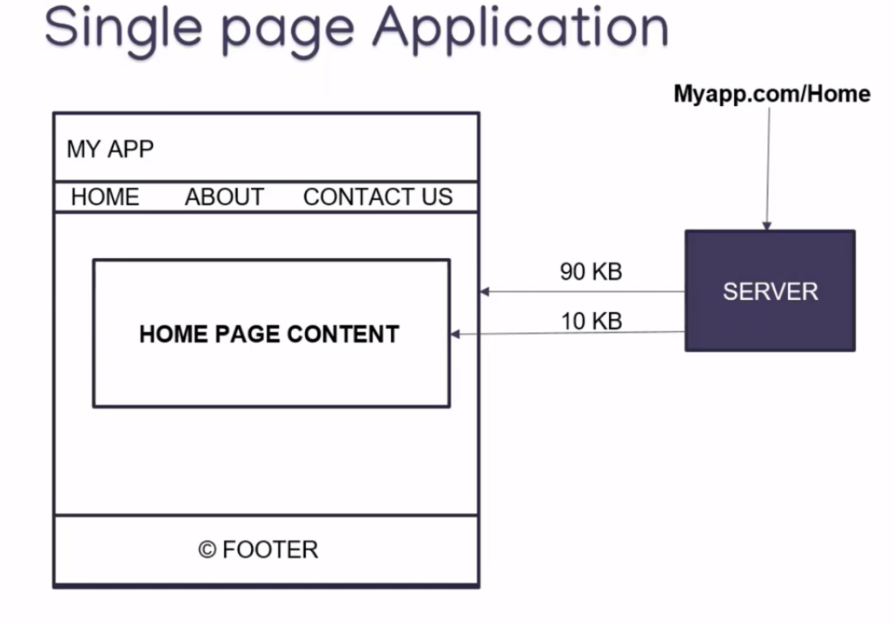

Slide 8
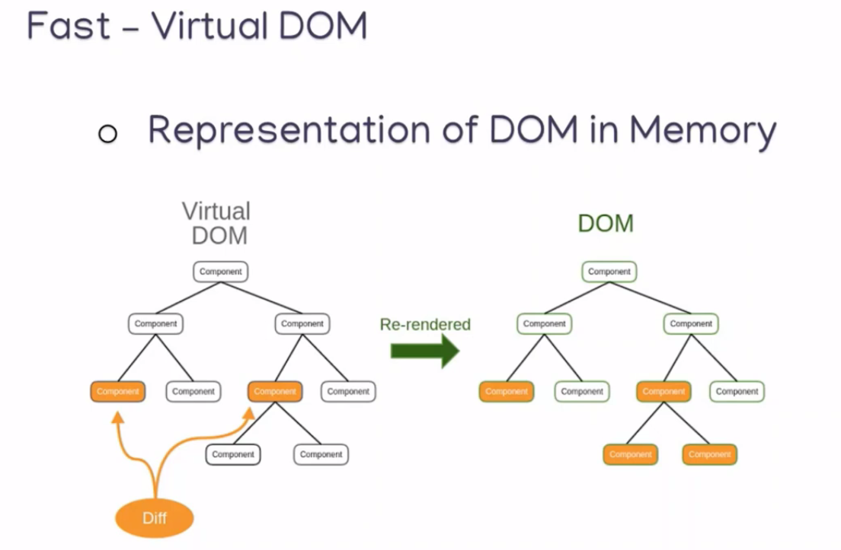

Slide 9
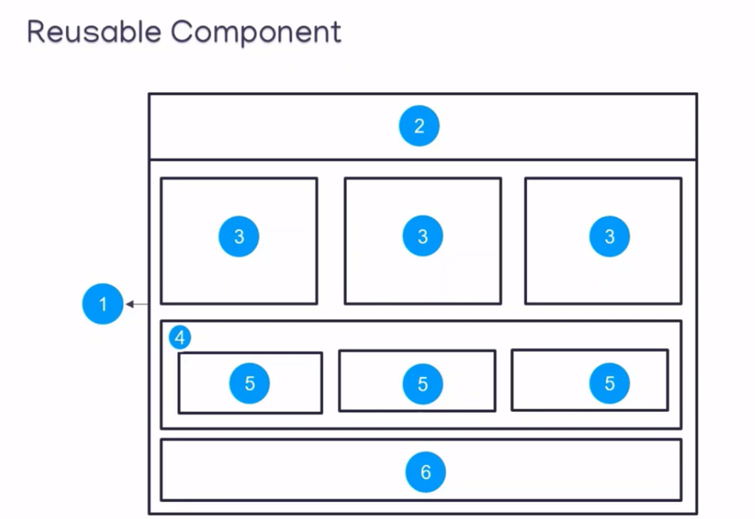

Slide 10

WHAT YOU SHOUD KNOW ?
HTML
CSS
JAVA SCRIPT
ES6 SYNTAX
Arrow functions
Classes
Module Import Export

Slide 11

SETIING UP A REACT ENVIRONMENT
We need to install NodeJS
Link : https://nodejs.org/en
Create react-app
npx create-react-app my-app
Run the react Applications
cd my-app
npm start

Slide 12
React create-react-app
Create a folder in your PC and open the Terminal From in side the folder.
“npx create-react-app app-name” used for create React Project.
Then “cd app-name” used for enter the project.
“npm start” is used for start the server.

Slide 13
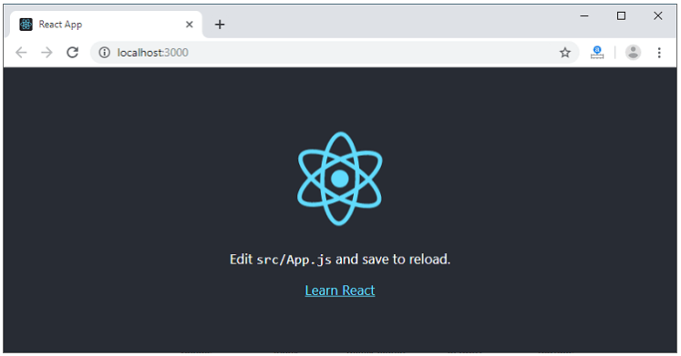
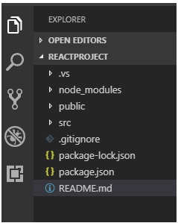
React create-react-app
NPM is a package manager which starts the server and access the application at default server http://localhost:3000. Now, we will get the following screen. Then open the project through VSCode

Slide 14
Continue…
In React application, there are several files and folders in the root directory. Some of them are as follows:
node_modules: It contains the React library and any other third party libraries needed.
public: It holds the public assets of the application. It contains the index.html where React will mount the application by default on the <div id="root"></div> element.
src: It contains the App.css, App.js, App.test.js, index.css, index.js, and serviceWorker.js files. Here, the App.js file always responsible for displaying the output screen in React.
package-lock.json: It is generated automatically for any operations where npm package modifies either the node_modules tree or package.json. It cannot be published. It will be ignored if it finds any other place rather than the top-level package.
package.json: It holds various metadata required for the project. It gives information to npm, which allows to identify the project as well as handle the project?s dependencies.
README.md: It provides the documentation to read about React topics.

Slide 15

React Features
JSX
Components
One-way Data Binding
Virtual DOM
Simplicity
Performance

Slide 16
Advantage of React
Easy to Learn and Use
Creating Dynamic Web Applications Becomes Easier
Reusable Components
Performance Enhancement
The Support of Handy Tools
Known to be SEO Friendly

Slide 17
React JSX
As we have already seen that, all of the React components have a render function
The render function specifies the HTML output of a React component.
JSX(JavaScript Extension), is a React extension which allows writing JavaScript code that looks like HTML.
In other words, JSX is an HTML-like syntax used by React that extends ECMAScript so that HTML-like syntax can co-exist with JavaScript/React code.

Slide 18
Why Use JSX ?
It is faster than regular JavaScript because it performs optimization while translating the code to JavaScript.
Instead of separating technologies by putting markup and logic in separate files, React uses components that contain both. We will learn components in a further section.
It is type-safe, and most of the errors can be found at compilation time.
It makes easier to create templates.

Slide 19
JSX Attributes
JSX use attributes with the HTML elements same as regular HTML
JSX uses camelcase naming convention for attributes rather than standard naming convention of HTML such as a class in HTML becomes className in JSX because the class is the reserved keyword in JavaScript.
We can also use our own custom attributes in JSX

Slide 20


